Slide 1
Crime rate analysis

Slide 2
Problem statement-user profile
numerous cities, such Delhi and Hyderabad have large datasets detailing crimes over the past decade. This data is broken down into type of crime (e.g. theft, murder, narcotics, etc.), time of day and year, geographic location, and more. Furthermore, cities have released a myriad of other datasets that may possibly relate: median income, location of police stations, . Combined with possible other outside sources, such as geo-located Tweets, newspaper headlines, etc) there is a copious amount of data to engineer features from and incorporate. This problem area is interesting because of the dynamics that drive crime and the level of granularity needed.

Slide 3
Problem statement-issue identification
Furthermore, this problem area is useful and novel. Being able to predict where crime will be most prevalent is of obvious benefit to a city and its citizens. The police force could allocate more resources to the predicted high-crime area in order to preempt criminal activity, and citizens would be safer by knowing what parts of a city they should avoid. However, in order to create actionable insights, the model created needs to be able to predict crime within a small time frame, for example around a day or week, and a small geographic region, e.g. a block or a neighborhood. Having described the available data and the possible difficulties, we can now refine the questions to investigate in this project. First and foremost, we are interested in seeing if we can predict the criminal incidents, perhaps for a specific type of crime, for a small time frame and geographic region. Second, we are interested in learning which features have the most predictive power with respect to crime. Having an understanding of driving factors, cities can better work to mitigate the risk factors for crime.

Slide 4
Objectives-use cases and stories
methods to analyze correlation between features we extract, as well as simple data exploration methodologies (such as analyzing trends over-time, etc.) will be helpful for feature prediction.
In the end, we will likely need to develop a more sophisticated model that more fully captures the dynamics of crime. For example, some research has been done into the mutually excitatory nature of crime, e.g. crime in one area causes surrounding areas to be more susceptible to crime.
These types of modeling enhancements may lead to better predictive power. We expect to spend a good amount of time tweaking different model ideas, and measuring their performance.

Slide 5
APPROACH/HIGH LEVEL DESIGN
Crime Analysis Using Apache Hadoop , Hive and Spark.
As a problem-driven project, a significant portion of this project will include implementing various regressions algorithms. The first challenge in this problem will be feature extraction
PCA or linear regression algorithms and other methods to analyze correlation between features we extract, as well as simple data exploration methodologies
We can even use simple linear regression on the features we ultimately extract. We expect numerous features, so we will need to enforce sparsity via regularization or some form of dimensionality reduction.

Slide 6
The current standard in crime forecasting is hotspot mapping, the process of mapping out occurrences of crime to identify high crime areas. The thought, then, is that placing more officers or other preventative resources in that areas with historically high rates of crime will more significantly reduce crime
Though simple, in some specific cases, this method had 90% accuracy when using the previous year’s data to forecast the next year, according to one study. Combined with the fact that hotspot mapping is easy to do with modern software and easy to understand, it is certainly the baseline to beat.

Slide 7
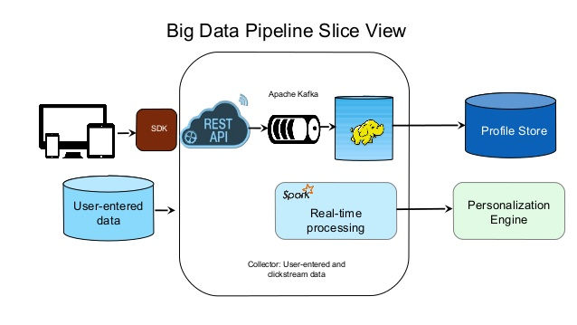

Slide 8
Thank you!

